Slide 1
Web Science:
Disinformation
(Part 1 - Intro to Disinformation)
CS 432/532
Old Dominion University
Permission has been granted to use these slides from Michele C. Weigle
This work is licensed under a Creative Commons Attribution-NonCommercial-ShareAlike 3.0 Unported License

Slide 2
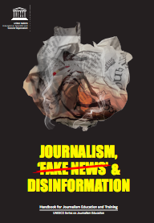
What is Disinformation?
Disinformation: Information that is false and deliberately created to harm a person, social group, organisation or country
Misinformation: Information that is false but not created with the intention of causing harm
Cherilyn Ireton and Julie Posetti, Journalism, 'Fake News' and Disinformation: A Handbook for Journalism Education and Training, UNESCO, 2018

Slide 3
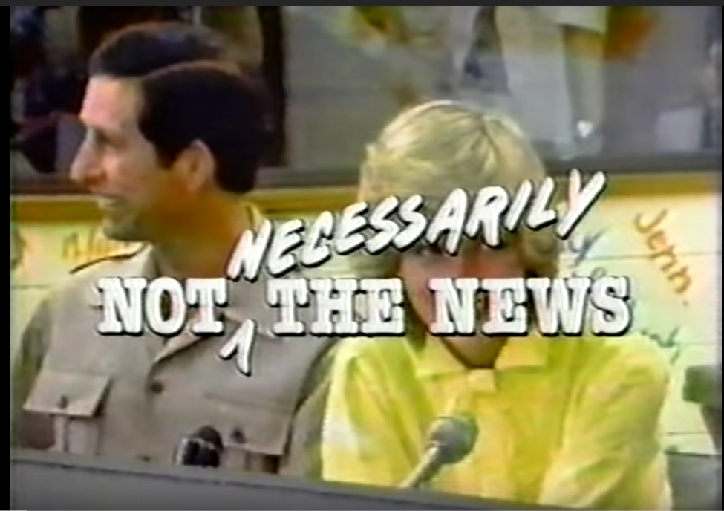
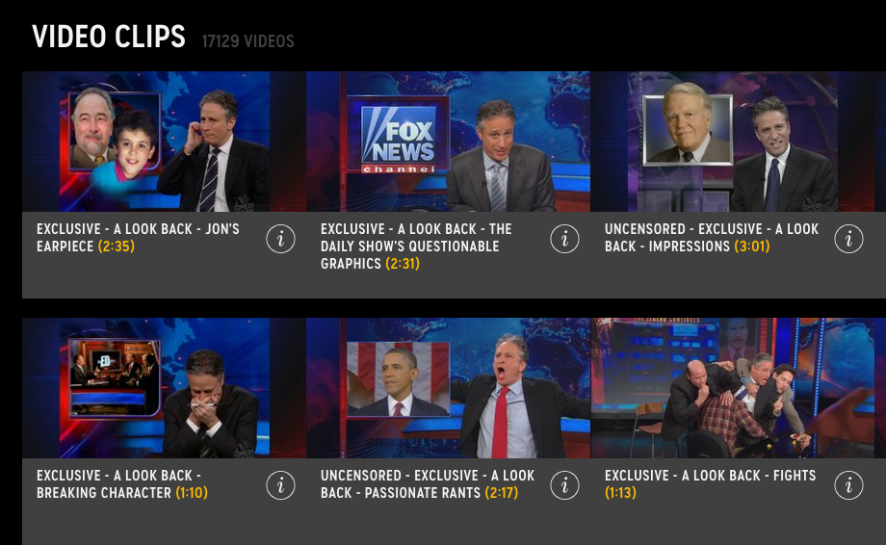
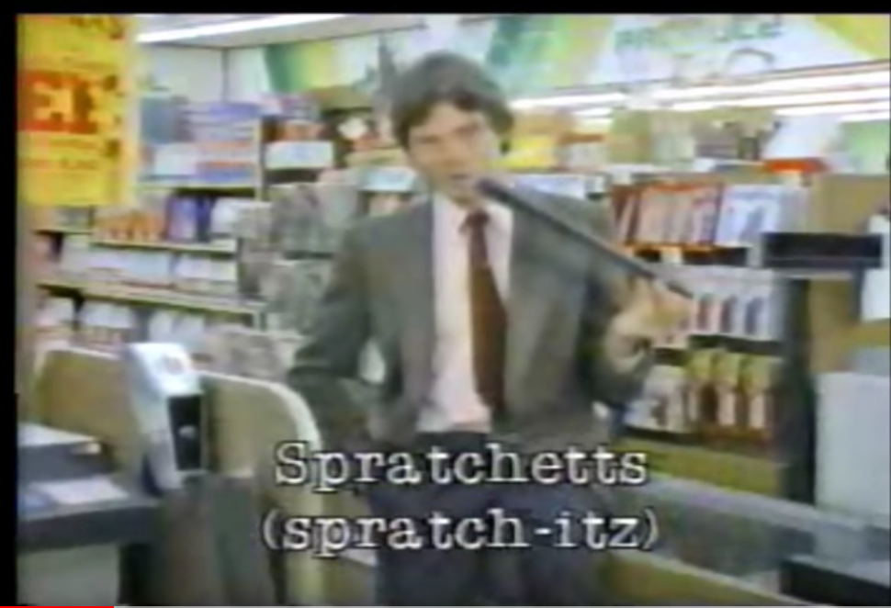
What is “Fake News”?
Not Necessarily The News - June 1983 (youtube)
The Daily Show with Jon Stewart - Series
The Daily Show with Jon Stewart (youtube)
Sniglets (Wikipedia)
Rich Hall - Supermarket Sniglets (1983)

Slide 4
What is “Fake News”?
Now it’s used as an attack, as a way to erode trust in traditional journalism
“If it’s news, it’s not fake.
If it’s fake, it’s not news.”
-Julie Posetti
Journalism, ‘Fake News’ and Disinformation: A handbook for journalism education and training (video)
Cherilyn Ireton and Julie Posetti, Journalism, 'Fake News' and Disinformation: A Handbook for Journalism Education and Training, UNESCO, 2018

Slide 5
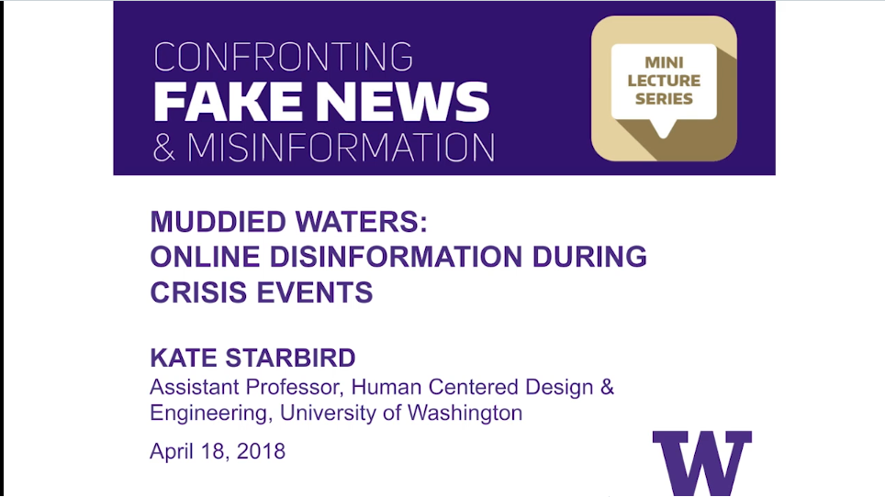
Muddied Waters: Online Disinformation During Crisis Events (Kate Starbird)

Slide 6
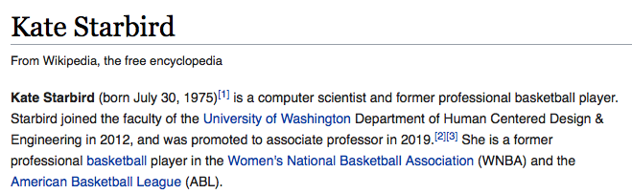
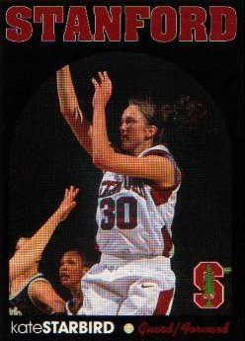
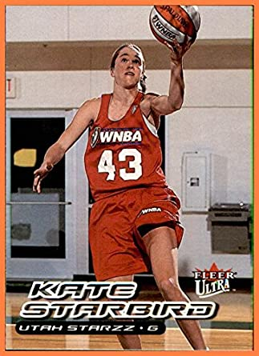
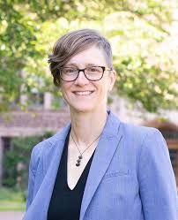
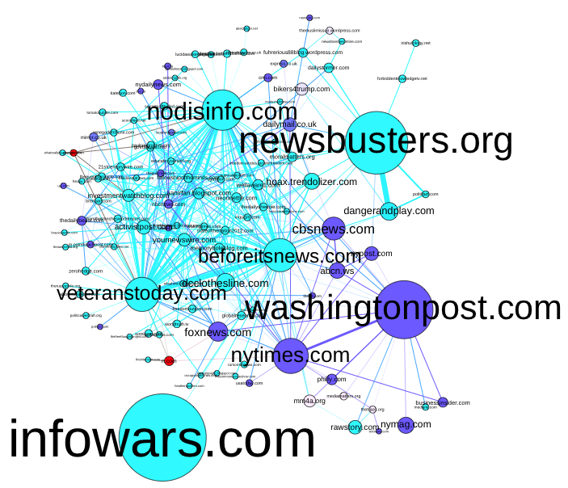
Kate Starbird (Wikipedia)
Kate's Homepage
"An Aggressive Old Dominion Pounds Stanford Out of the Final", Mar 29, 1997 (youtube video)
Information Wars: A Window into the Alternative Media Ecosystem

Slide 7
“Muddied Waters”
Disinformation terminology
Information propagation on social media
We’re all susceptible - echo chambers, filter bubbles
One goal is to sow division within a society
They’re trying to divide us and make us not trust information
Be aware of your own cognitive biases
If you don’t think you have any, you might be the problem
Muddied Waters: Online Disinformation During Crisis Events (Kate Starbird)
“If it makes you self-righteous, indignant, outraged against the other side, then probably someone is manipulating you.” - Kate Starbird

Slide 8
Web Science:
Disinformation
(Part 2 - More Disinformation)
CS 432/532
Old Dominion University
Permission has been granted to use these slides from Michele C. Weigle
This work is licensed under a Creative Commons Attribution-NonCommercial-ShareAlike 3.0 Unported License

Slide 9
Muddied Waters: Online Disinformation During Crisis Events (Kate Starbird)

Slide 10
Public Opinion about Disinformation
Survey of 2200 adults in the US
80% - see disinformation once/week
80% - confident in recognizing false news
People are the most trustworthy sources of info
74% family
72% people like me
70% friends
Institute for Public Relations, 2019 IPR Disinformation in Society Report

Slide 11
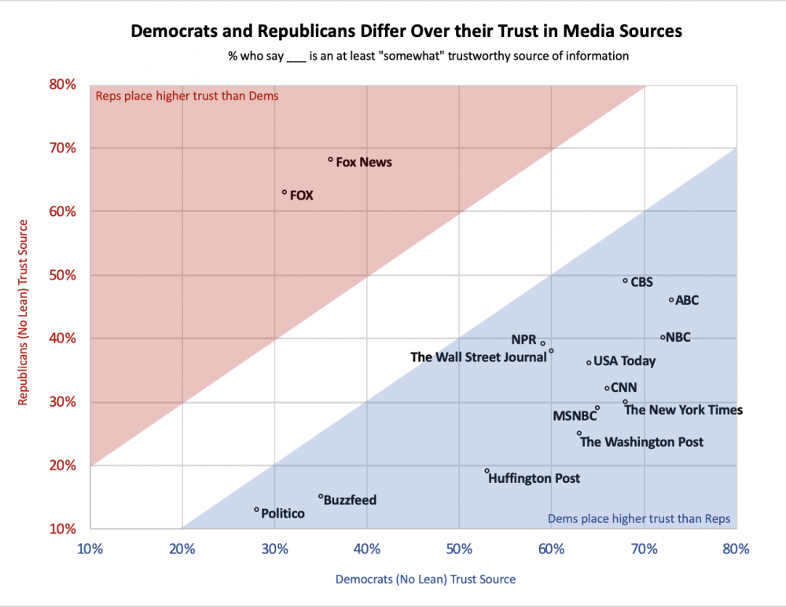
Trusted News Sources
Institute for Public Relations, 2019 IPR Disinformation in Society Report

Slide 12
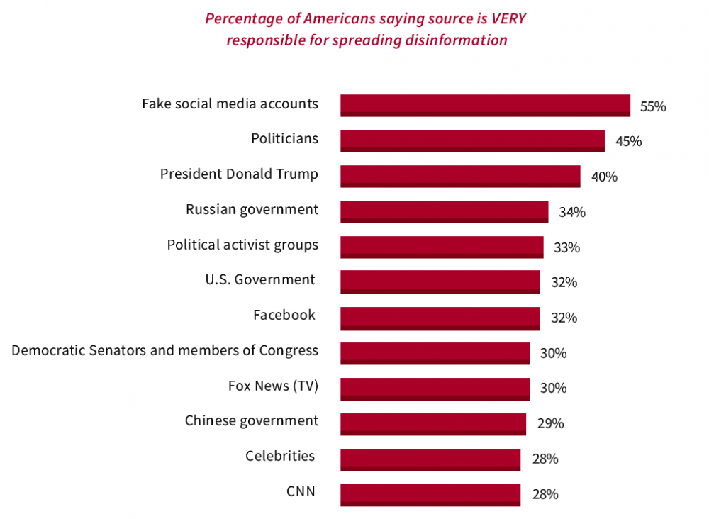
Who is Spreading Disinformation?
Institute for Public Relations, 2019 IPR Disinformation in Society Report

Slide 13
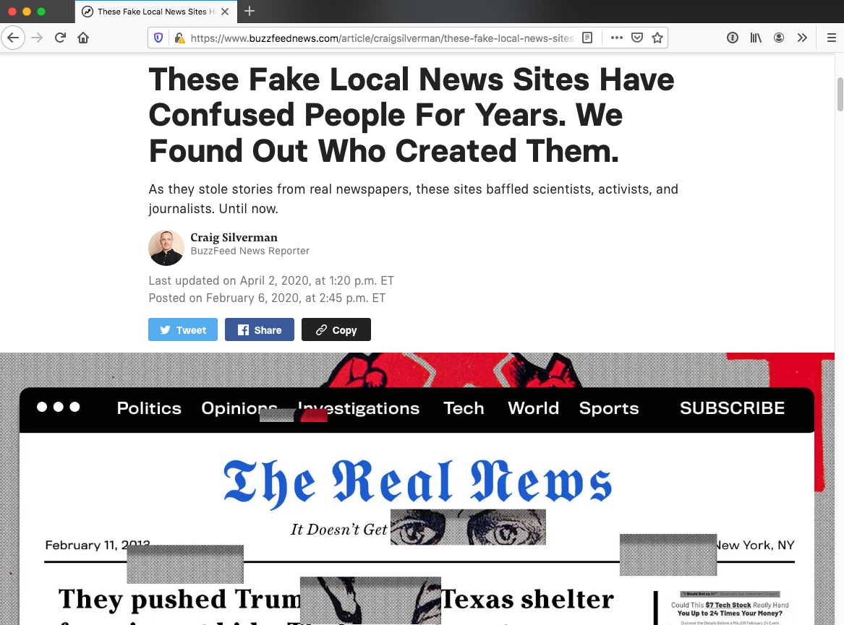
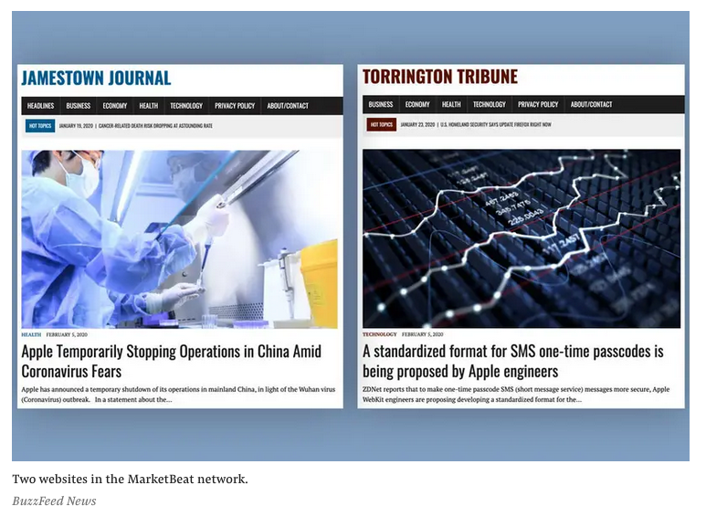
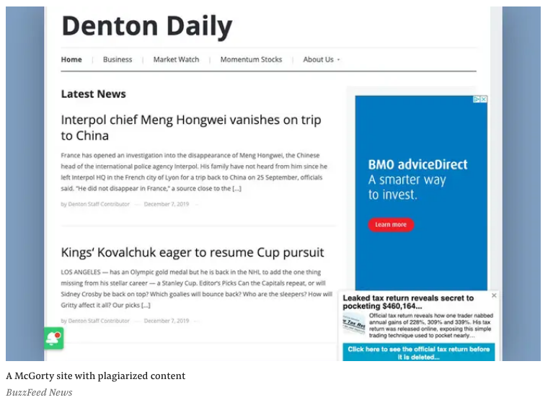
Fake Local News
Websites with names like Livingston Ledger, Denton Daily, Hoback Herald
Plagiarizing stories from major news organizations
Network of sites
Manipulating Google News and search results
Goal to earn money through ads
“These Fake Local News Sites Have Confused People For Years. We Found Out Who Created Them”, BuzzFeed News, Feb 2020,

Slide 14
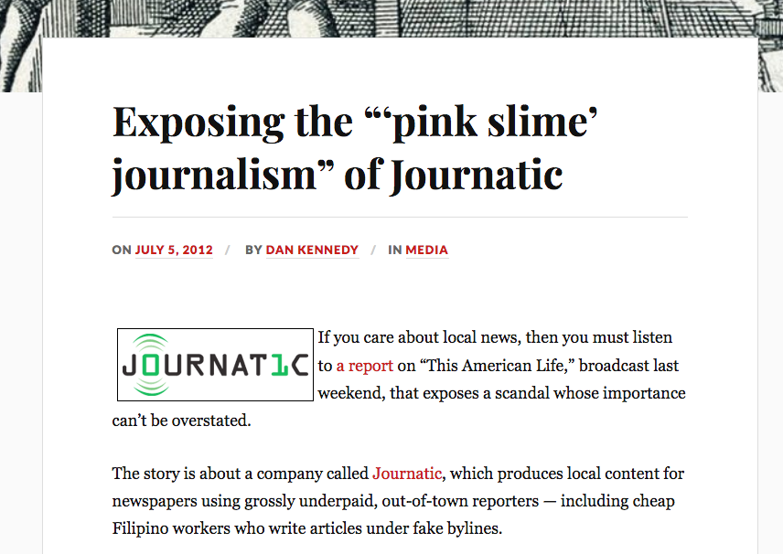
“Pink Slime” Journalism
Producing “local” content for newspapers using out-of-town “reporters”
“Exposing the “‘pink slime’ journalism” of Journatic”
“Switcheroo”, This American Life, 2012
Pink slime (Wikipedia)

Slide 15
Fake Local News Used for Politics
“Russian Influence Campaign Sought To Exploit Americans' Trust In Local News”, NPR, 2018
“Hundreds of ‘pink slime’ local news outlets are distributing algorithmic stories and conservative talking points”, Columbia Journalism Review, 2019
“Hiding in Plain Sight: PAC-Connected Activists Set Up ‘Local News’ Outlets”, Snopes, 2019

Slide 16
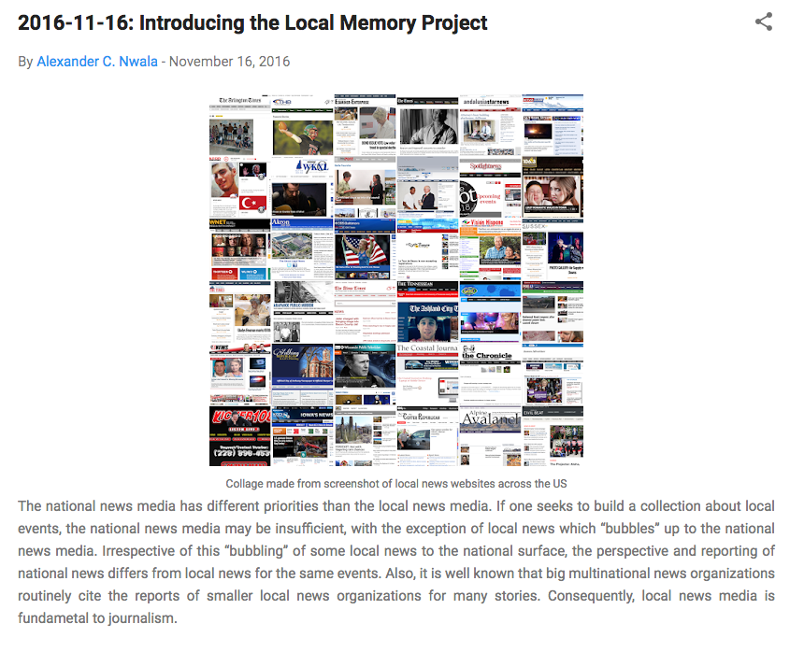
Local Memory Project
Assist in building collections of news stories from local sources
Can highlight stories that might not be covered by national media
Introducing the Local Memory Project, WS-DL blog
Local Memory Project

Slide 17
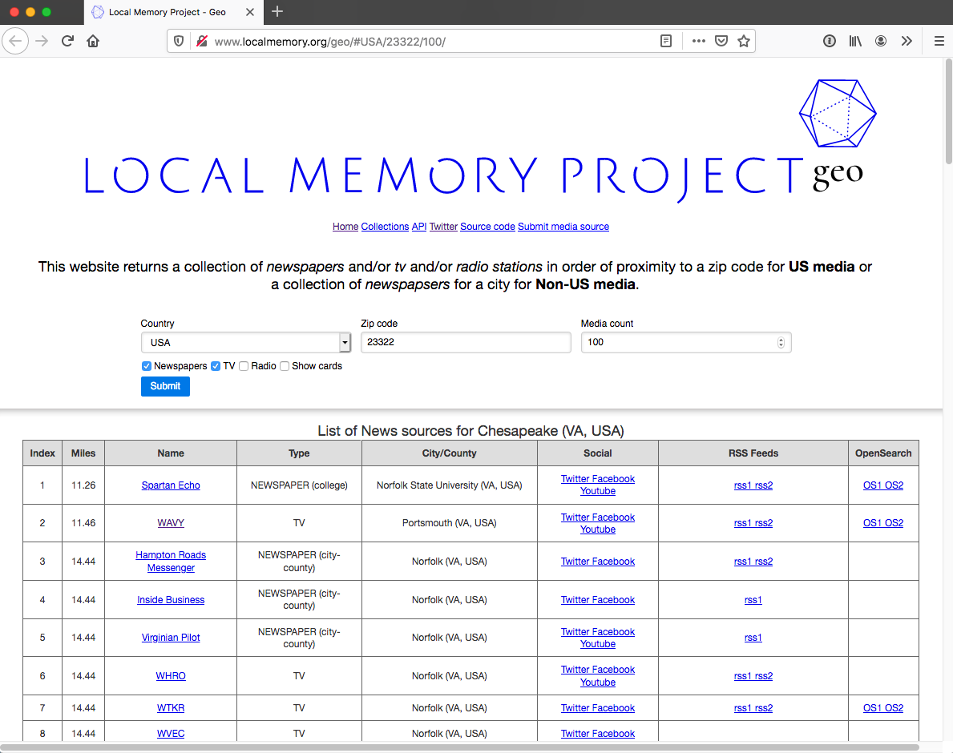
Local Memory Project - geo
Geo - Local Memory Project

Slide 18
Manipulating Social Media
“Inside the hate factory: how Facebook fuels far-right profit”, The Guardian, Dec 5, 2019
“I Found Election Interference And No One Cared”: One US Veteran’s Fight To Protect His Compatriots Online, BuzzFeed News, Dec 30, 2019
“Sanders supporters have weaponized Facebook to spread angry memes about his Democratic rivals”, The Washington Post, Jan 24, 2020,
“How conservatives learned to wield power inside Facebook”, The Washington Post, Feb 20, 2020

Slide 19
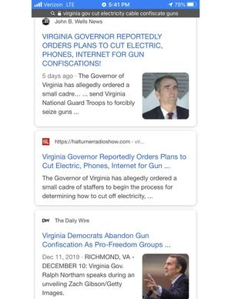
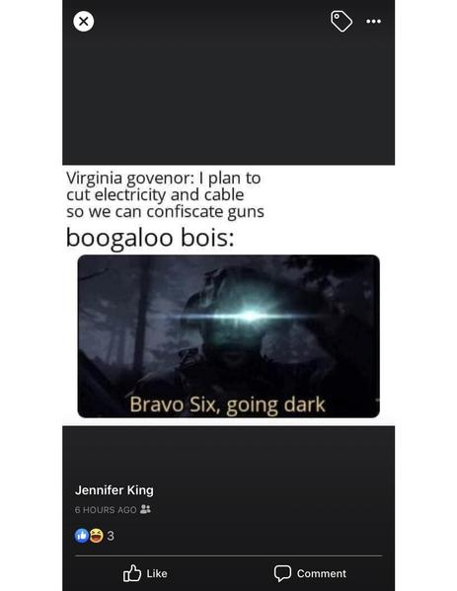
Manufactured Consensus
On Dec 20, 2019, I saw this meme from a friend in Arkansas on Facebook.
The only result on the 1st page that doesn’t echo the hoax is a MediaMatters article refuting the hoax.
I used Google to search for
“virginia gov cut electricity cable confiscate guns“
Woolley and Guilbeault, “Computational Propaganda in the United States of America: Manufacturing Consensus Online”

Slide 20
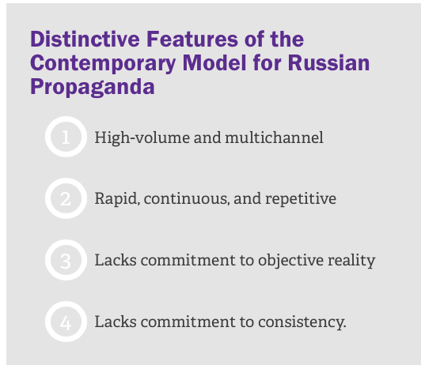
“Firehose of Falsehood”
Paul and Matthews, “The Russian ‘Firehose of Falsehood’ Propaganda Model: Why It Might Work and Options to Counter It”, The Rand Corporation, 2016

Slide 21
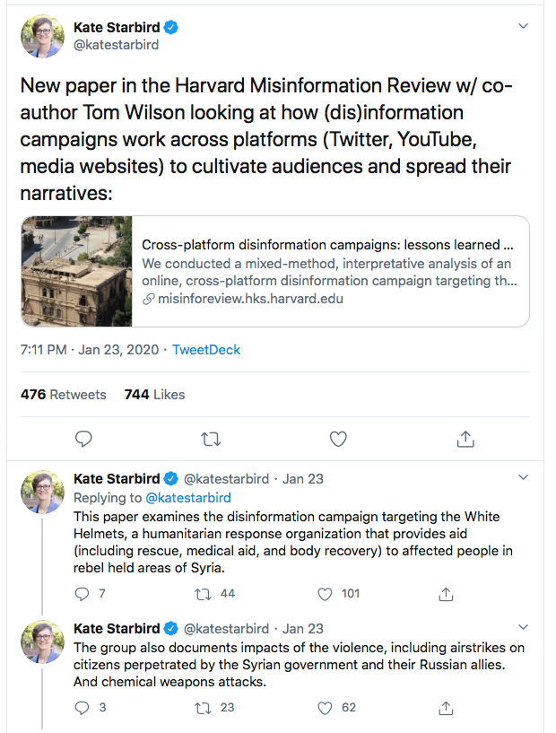
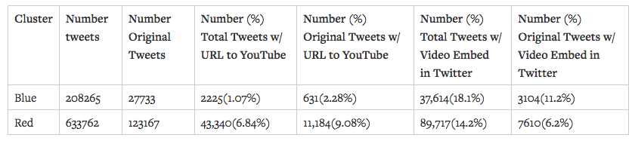
Multichannel
Kate Starbird on Twitter: "New paper in the Harvard Misinformation Review w/ co-author Tom Wilson looking at how (dis)information campaigns work across platforms
Pro
Anti
Wilson and Starbird, “Cross-platform disinformation campaigns: lessons learned and next steps”, Harvard Misinformation Review, Jan 14, 2020

Slide 22
“Firehose of Falsehood”
Paul and Matthews, “The Russian ‘Firehose of Falsehood’ Propaganda Model: Why It Might Work and Options to Counter It”, The Rand Corporation, 2016

Slide 23
Combatting the “Firehose of Falsehood”
Don't expect to counter the firehose of falsehood with the squirt gun of truth (!!)
Find ways to help put raincoats on those at whom the firehose of falsehood is being directed
Don't direct your flow of information directly back at the firehose of falsehood
Increase the flow of persuasive information and start to compete
Turn off (or turn down) the flow
Paul and Matthews, “The Russian ‘Firehose of Falsehood’ Propaganda Model: Why It Might Work and Options to Counter It”, The Rand Corporation, 2016

Slide 24
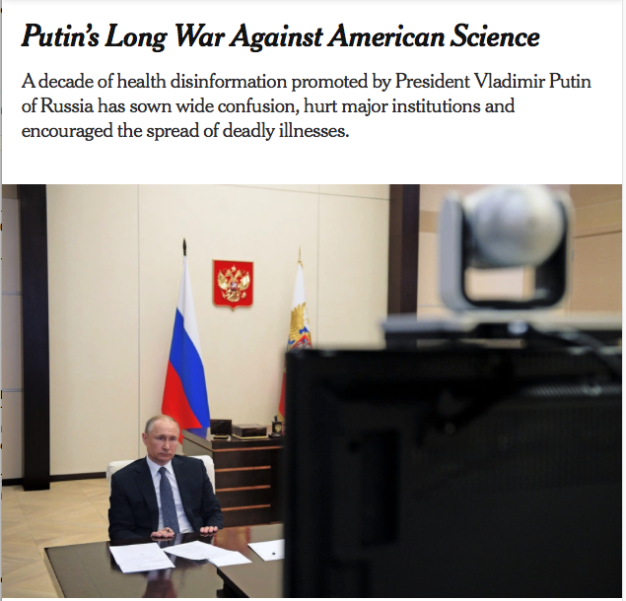
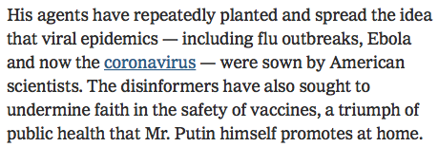
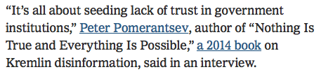
Russian Propaganda and Health Disinformation
"How Russia’s Troll Farm Is Changing Tactics Before the Fall Election", NY Times, Mar 29, 2020
“Putin’s Long War Against American Science”, NY Times, Apr 13, 2020

Slide 25
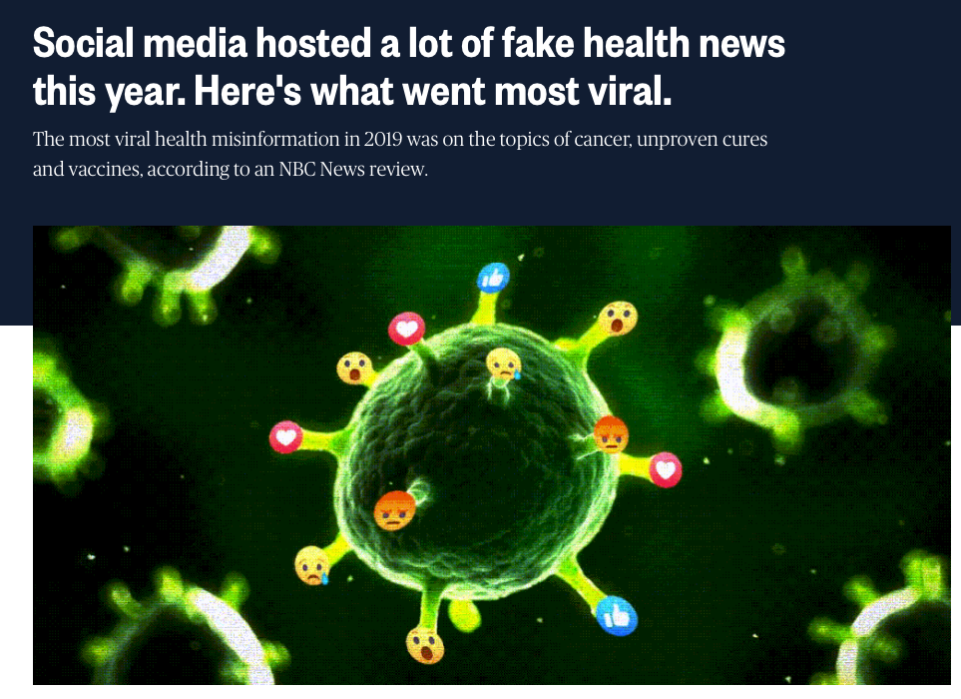
Health Disinformation
“Social media hosted a lot of fake health news this year. Here's what went most viral.”, NBC News, Dec 29, 2019
“Firehosing: the systemic strategy that anti-vaxxers are using to spread misinformation”, The Guardian, Nov 2019,

Slide 26
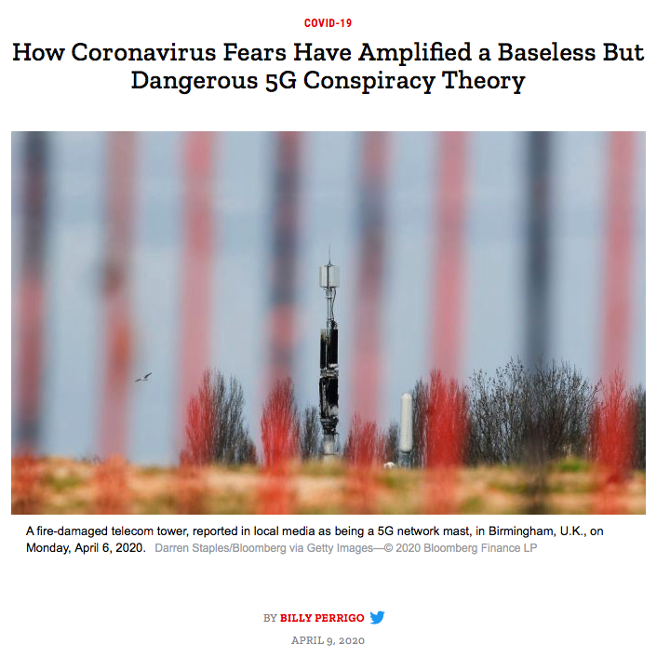
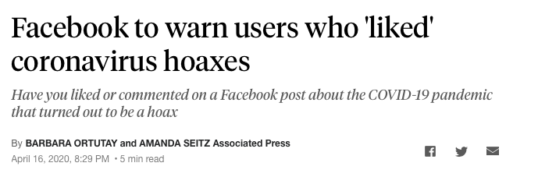
Conspiracy Theories Can Have Real-World Consequences
Facebook to warn users who 'liked' coronavirus hoaxes, Associated Press report, Apr 16, 2020
“How Coronavirus Fears Have Amplified a Baseless But Dangerous 5G Conspiracy Theory”, Time, Apr 9, 2020

Slide 27
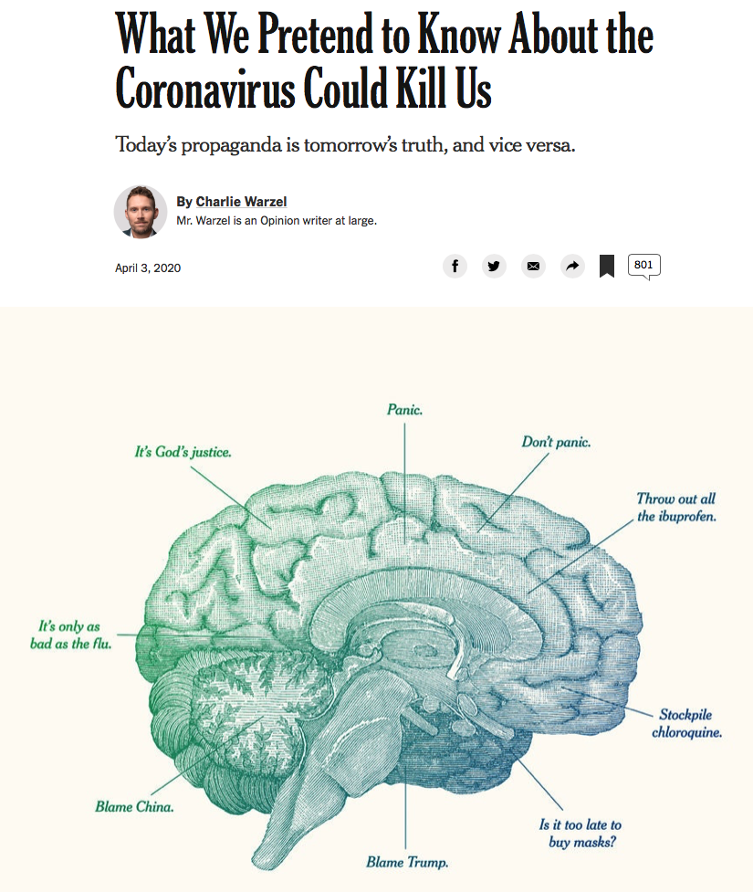
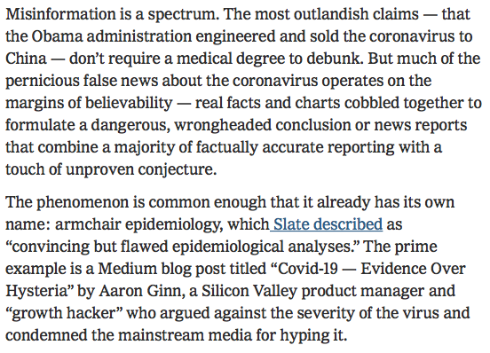
Armchair Epidemiology
Dr. Bergstrom’s Twitter thread refuting Ginn’s article
“The Professors Who Call ‘Bullshit’ on Covid-19 Misinformation”, Wired, Mar 24, 2020
Dr. Starbird’s Twitter thread on the Twitter analysis in the Wired article
"Flatten the Curve of Armchair Epidemiology", Mar 19, 2020
“What We Pretend to Know About the Coronavirus Could Kill Us”, NY Times, Apr 3, 2020

Slide 28
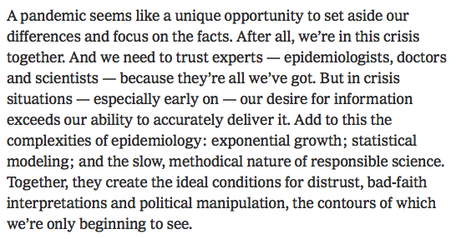
Ideal Conditions for Distrust
“What We Pretend to Know About the Coronavirus Could Kill Us”, NY Times, Apr 3, 2020

Slide 29
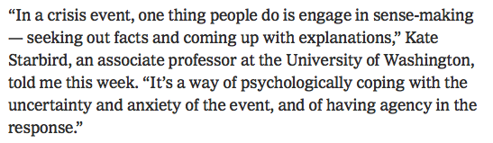
Engaging in Sense-Making
“What We Pretend to Know About the Coronavirus Could Kill Us”, NY Times, Apr 3, 2020
“I ask us as information participants to tune in to how our anxiety fuels information-seeking and information-sharing activities that may make us susceptible to spreading false rumors and/or disinformation. This can mean slowing down. It can mean doing a better job of vetting our sources... It can also mean choosing not to share content that we’re just not sure about. And it can even mean stepping away from our feeds when we realize they aren’t helping us resolve the anxiety and uncertainty and are just amplifying them. We can think about this as the “hand-washing” for the infodemic accompanying the pandemic.”
Starbird, “How a Crisis Researcher Makes Sense of Covid-19 Misinformation”, Mar 9, 2020

Slide 30
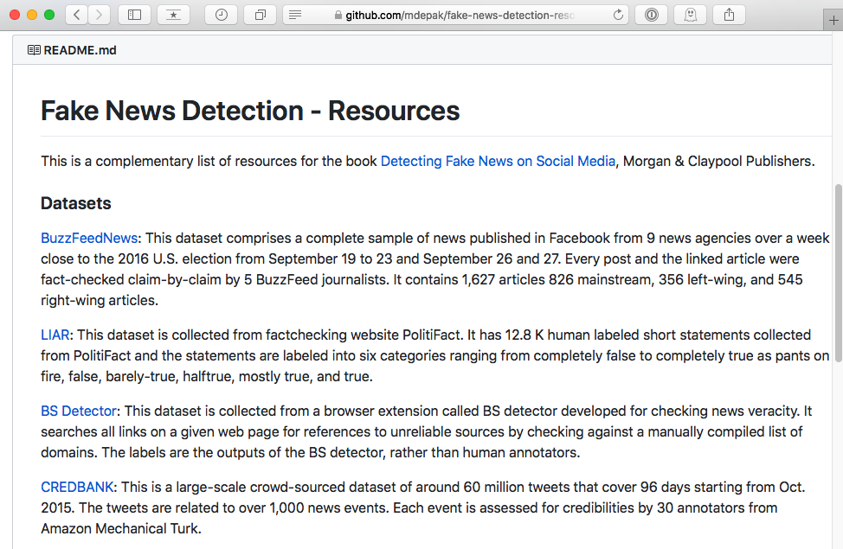
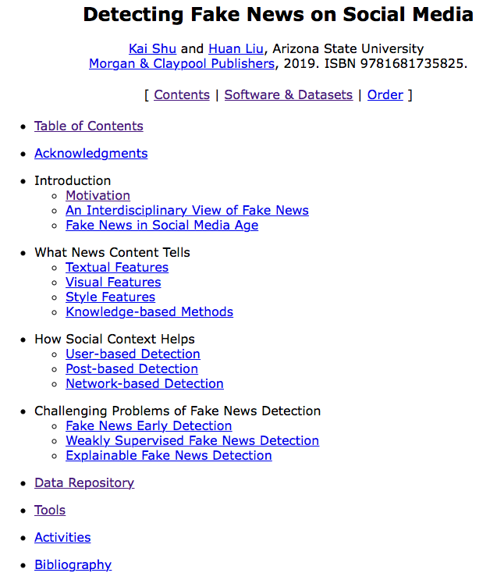
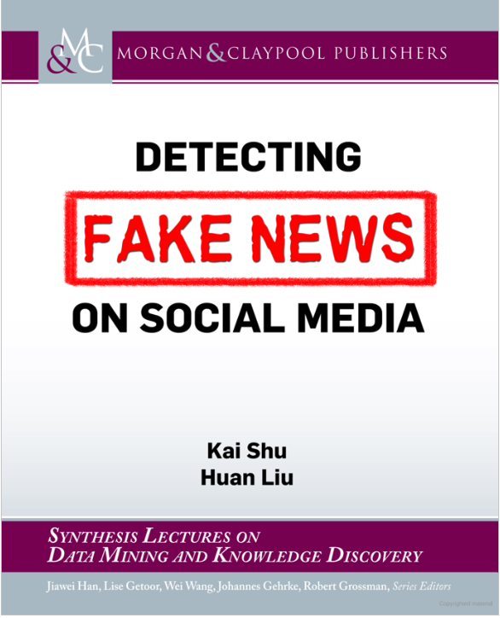
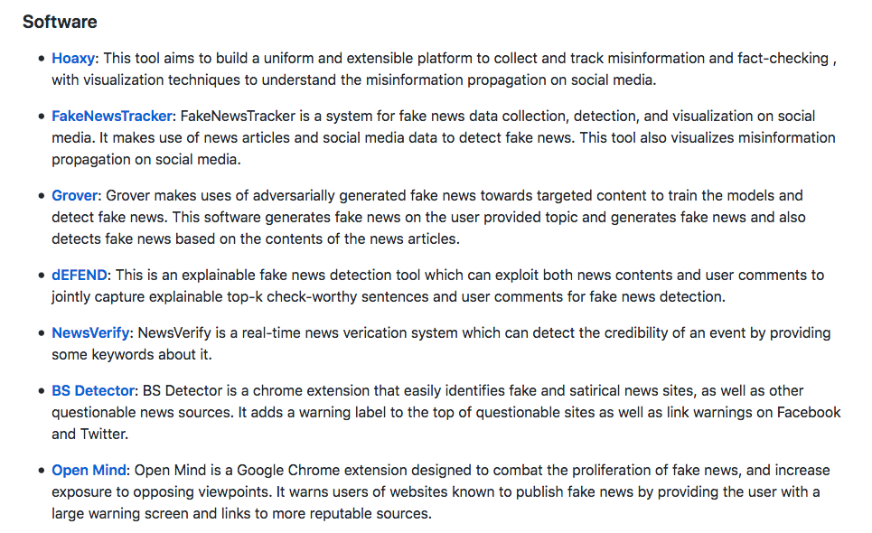
Detecting Fake News on Social Media
Detecting Fake News on Social Media
mdepak/fake-news-detection-resources: 📖 A curated list of resources dedicated to Fake News Detection

Slide 31
Objectives
Explain the difference between disinformation and misinformation.
Explain how echo chambers and filter bubbles support motivated reasoning and confirmation bias.
Explain how an understanding of social networks is important in understanding how misinformation and disinformation spreads.
List the 4 distinctive features of contemporary Russian propaganda.
List and explain ways to combat the “firehose of falsehood”.

